Slide 1

Inflation Web Scraper
Albert Lepree, Francisco Greenaway, Tyler Krawec

Slide 2

Curious about today's Market?
In recent months, whenever high inflation data was reported, the stock and crypto markets saw steep sell offs. With the ever-changing volatility of today’s global stock market, comes some key analytics that will be crucial in deciding how assets are affected by the value of our dollar. Our groups mission is to utilize modern technology in a way that make those factors visible. By scraping data from multiple, reliable sources and compiling a set of relevant information, we hope to bring some insight about how the strength of our dollar and inflation has affected asset prices.

Slide 3

Research Questions
Which asset is the most profitable during periods of high inflation?
How much does inflation affect asset prices?
Is real estate a good hedge against inflation?

Slide 4

Our Project
We built a web scraper that collects data such as yearly inflation rates and asset performance. After collection we plan on using a data frame to perform analysis in order to see how inflation affects different components of the stock market. We will be researching the effects of inflation, if any, on different asset classes such as the S&P 500, Bitcoin, Real estate, etc. We will do this using python for the web scraper; more specifically we will use “beautiful soup” to pull data from various sources.

Slide 5




Where we used networking
Using Microsoft Teams to communicate with each other
Using Github for version control (pulling, cloning, and committing)
Making request to websites using the 'http' protocol
Using Jupyter Notebooks to display plots (localhost:3000)
Importing of Libraries such as matplotlib, beautifulsoup, etc.

Slide 6

Networking in depth
Github VCS:
Remote Repository (Server)
Local Repository (Our Computers)
Transfer data (ex. Committed code) through plain Git, HTTPS, HTTP, or SSH protocols
Requests.get()
Client(Computer making the request)
Server(URL we are requesting)
Uses TCP Protocol
TCP connection established
Client sends HTTP GET request to server
Server responds with webpage
TCP closes connection
Python Import Protocol
Finder objects
Locates built-in, frozen, and 'Import path ' locations
Loader object
Loads a module (Returned by the finder object)

Slide 7
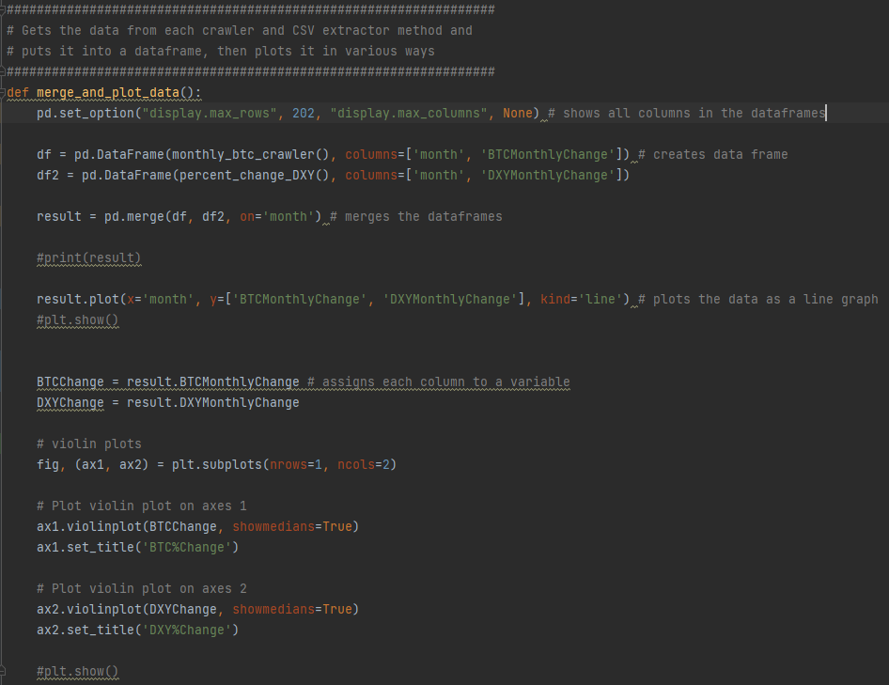
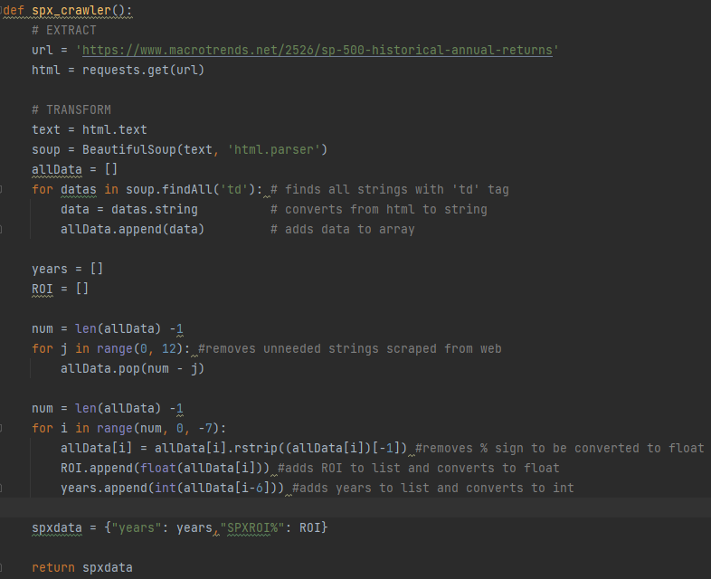

Title:
Example Code

Slide 8
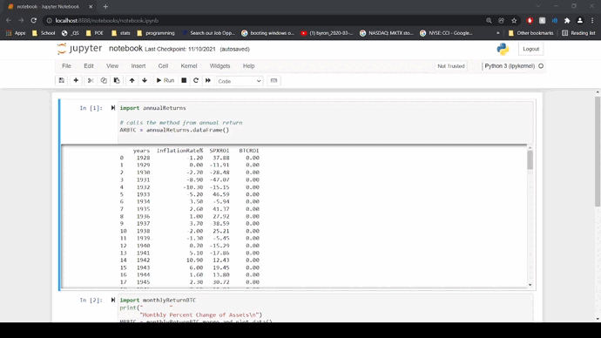
Title:
Jupyter Notebook Demonstration

Slide 9

Networking Issues we encountered
OUR SOLUTION
1. Upgrading to Pycharm Pro
2. Deleting current 'venv' file then configuring a new interpreter.
3. Finding other sources that are scrapable
4. Re formatting our code to work with the website changes.
1. Installing and getting Jupyter Notebooks to work on our machines
2. Pulling code from Github causing issues with our 'venv' and interpreter
3. While using some sources, the data was unable to be parsed after scraped. Also, some sites could not be scraped, so finding data was tricky.
4. When scraping data using beautiful soup the source website changed on occasion causing errors in our code.

Slide 10
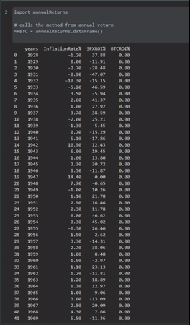
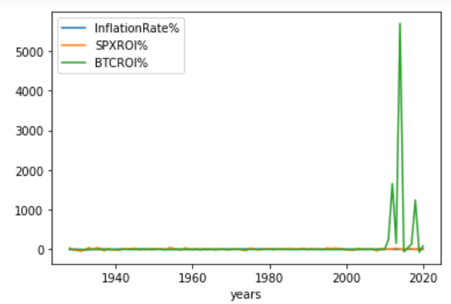
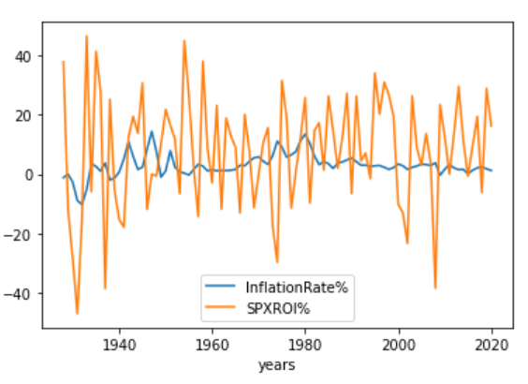
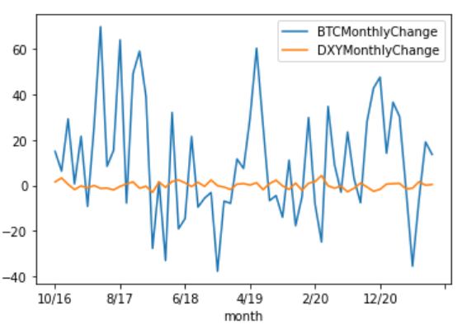
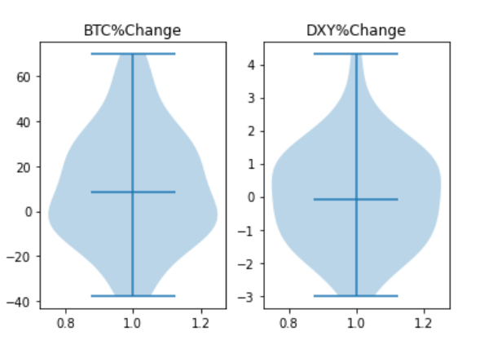
Title:
Initial data presentation

Slide 11
Title:
We originally scraped the annual change of bitcoin, inflation rate, and annual change of the S&P 500. Upon doing this we noticed that bitcoin is not comparable to almost any other assets because of how quickly it changes. Due to this we decided to move in a different direction in order to answer our research questions.
Initial Findings

Slide 12
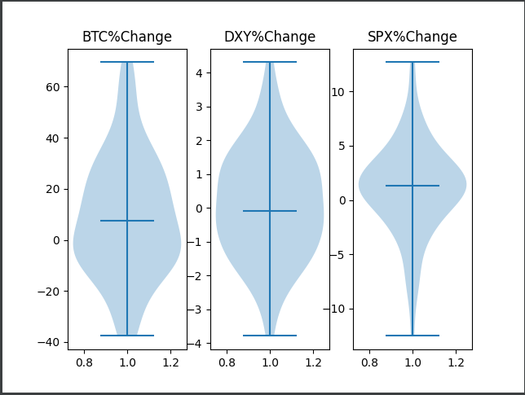
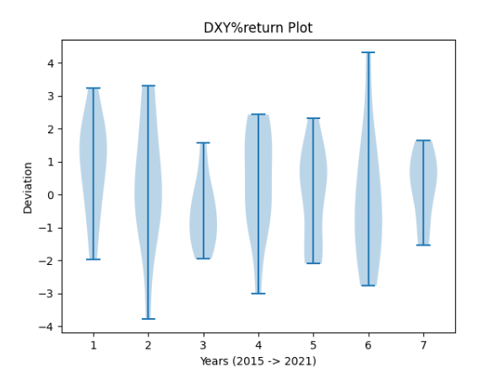
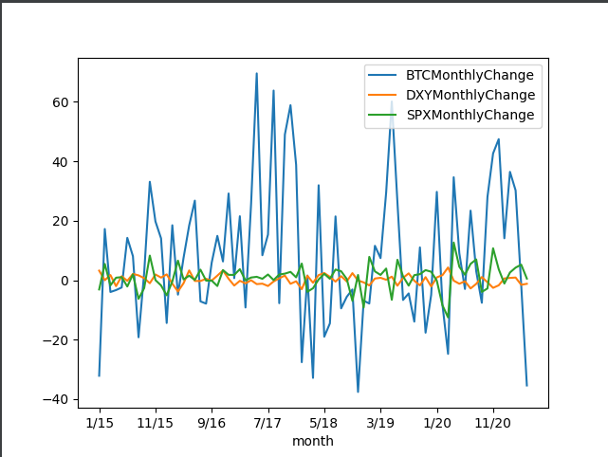
Title:
We realized that the only way to get comparable data was to get it on a monthly basis. On the left you can see the standard distribution of percent change by month of the different assets. Additionally, you can see a clearer picture of the changes in the different assets.
Changing Directions

Slide 13
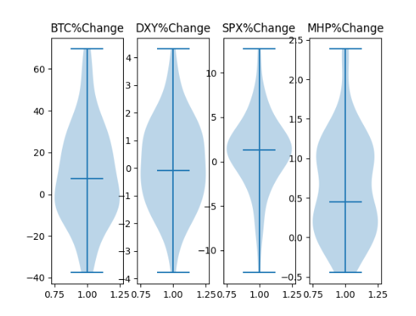
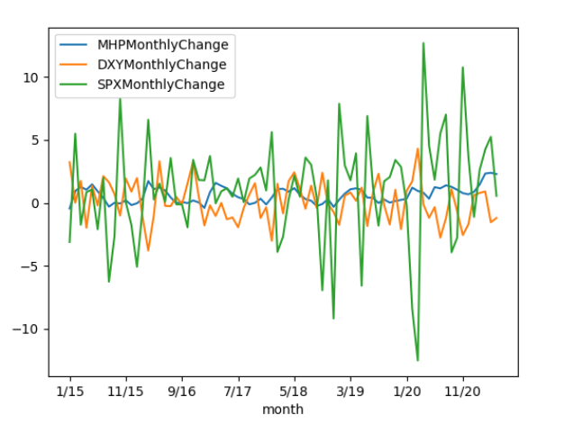
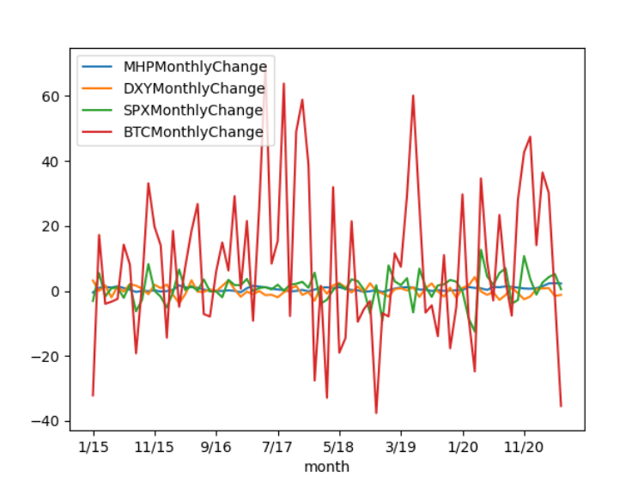
Title:
Incorporating the housing data allows you to visualize how real estate value has changed in comparison the other assets since 2015.
Removing BTC as the outlier allows for another perspective of the graphs
Final data

Slide 14
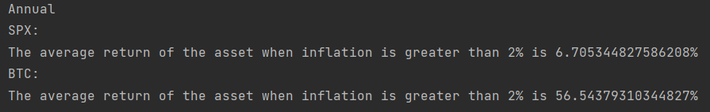
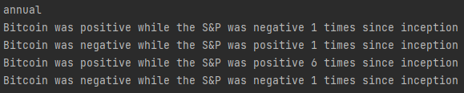
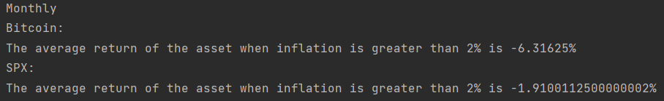
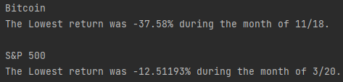
After Extracting and transforming this data, we decided to find out the average returns when inflation was high and the results are on the left. We realized that bitcoin more often than not, follows the S%P 500. That being said, the data also showed that bitcoin is a better hedge against inflation than the same index (according to the data).

Slide 15
Conclusion?
Upon doing this research, we realized:
High inflation doesn’t have a directly negative effect on any assets
Most assets may sell off during periods of high inflation
It is fear of monetary tightening that really drives the sell offs.
High inflation has a positive effect on asset prices.

Slide 16
What's next?
Add a data base to make it easier to query data.
Add functionality to make the system scrape data for user entered ticker symbols.
Clean up the code, make it a lot smoother.
Add documentation.
Make it more current.
Update the data every time the code is ran.
Make Violin Plots for BTC and S&P that are separated by year.

Slide 17
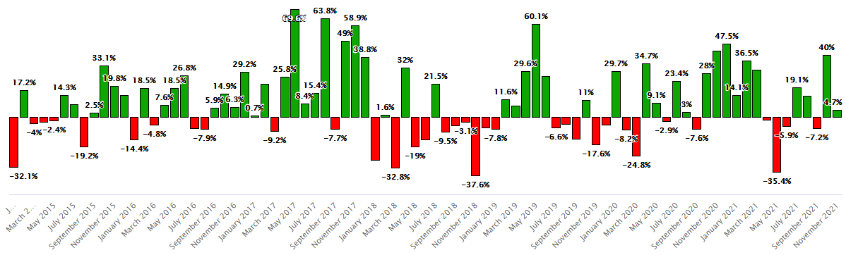
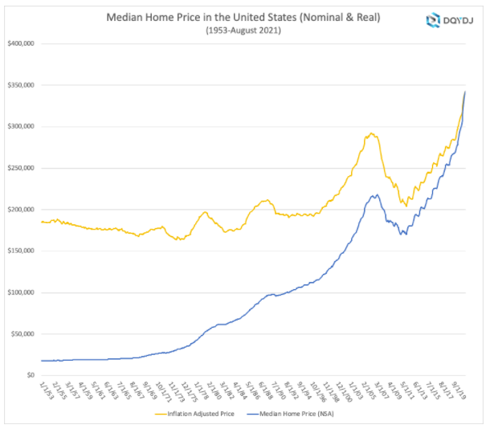
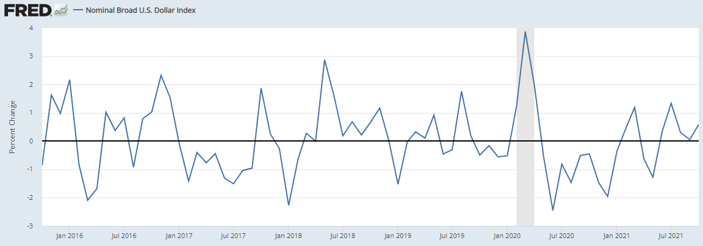
Title:
Data Sources:
Monthly
Statmuse.com​
Bitcoin​
https://dqydj.com/
Median Home Prices
Fred.Stlousfed.org
Dollar index (DXY)

Slide 18
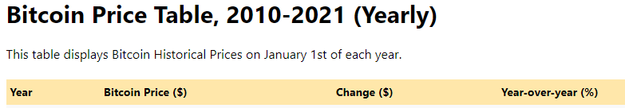
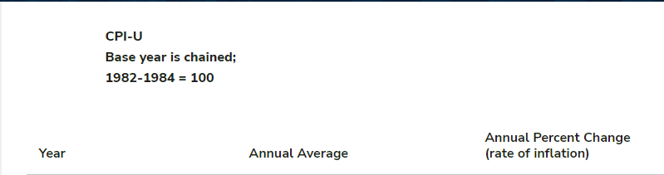
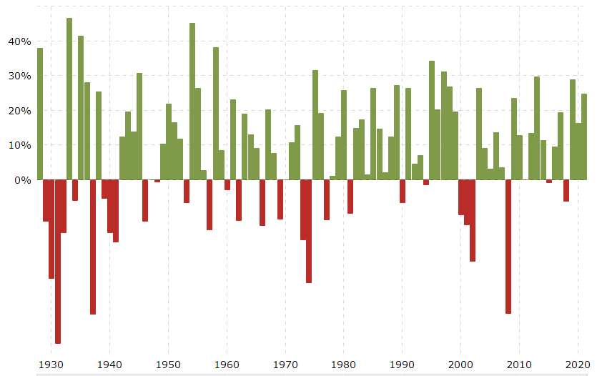
Title:
Data Sources:
Annually
In2013dollars.com
Minneapolisfed.org
Macrotrends.net
S&P 500

Slide 19

Credits
Francisco Greenaway:
Bitcoin annual return scraper
Percent change in DXY ETL
Plotting Data Frames
Albert Lepree
Plotting Data frames
Bitcoin monthly change scraper
SPX annual return scraper
Inflation annual change scraper
Tyler Krawec
Annual Change in Real Estate price Scraper
Monthly change in Real estate price scraper

